Slide 1


Slide 2
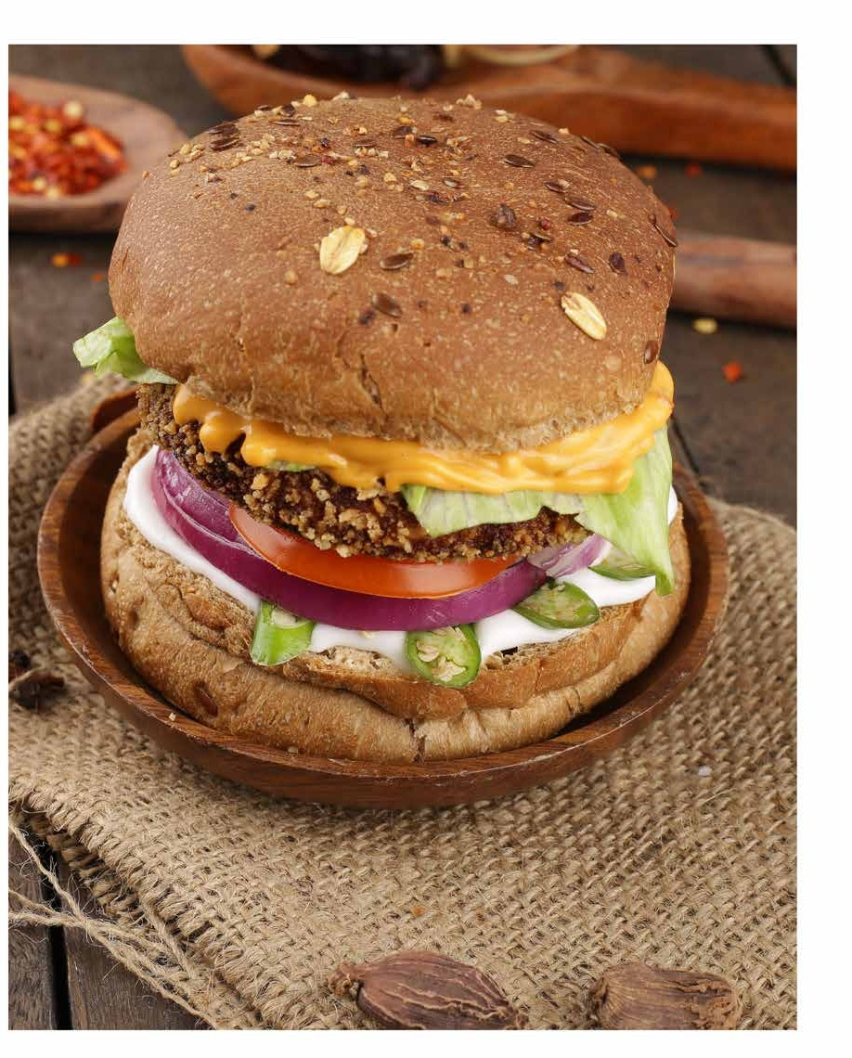

Slide 3


01
03
02
05
03
06

Slide 4


Slide 5


01
07
02
06
03
05
04

Slide 6



Slide 7








Slide 8




Slide 9







Slide 10




Slide 11

$160
$141.90
Revenue in Billions US Dollars ($)
$140
$120
$104.08
$100
$76.34
$80
$55.99
$60
$40
$20
$41.07
$30.12
$0
2015
2016
2017
2018
2019
2020
Market Forecast

Slide 13
8000
30%
7000
20%
24.4%
26.1%
6000
Percentage of Revenue
10%
18%
Amount in INR
5000
0%
4000
Total Revenue FCP
-10%
-43.3%
-1%
PAT
3000
-20%
2000
-30%
1000
-40%
Year 1
Year 2 Year 3 Year 4
Change over the years
Year 5
-50%
-1000
Year 1
Year 2 Year 3
PAT over the years
Year 4
Year 5

Slide 14


Slide 15


Slide 16

17%
13%
17%
12%
3%
28%
3%
7%

Slide 17





Slide 18




Slide 19



